Slide 1

OOP

Slide 2
A customer lives at exactly 1 place
Public
Customer
Customer
Customer
Private
place
1
place
*
place
place
Address
Address
Address
OhYeah
A
B
C
D

Slide 3
A customer lives at exactly 1 place
Public
Customer
Customer
Customer
Private
place
1
place
*
place
place
Address
Address
Address
OhYeah
A
B
C
D

Slide 4
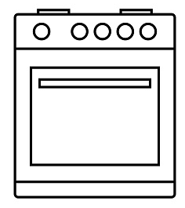
HOVEN
A French Kitchen has a hoven
Kitchen
Kitchen
Kitchen
Hoven
1
1
1
FrenchKitchen
Hoven
FrenchKitchen
Hoven
FrenchKitchen
B
C
A

Slide 5
HOVEN
A French Kitchen has a hoven
Kitchen
Kitchen
Kitchen
Hoven
1
1
1
FrenchKitchen
Hoven
FrenchKitchen
Hoven
FrenchKitchen
B
C
A

Slide 6
A student is a person and study in a school
Personn
Personn
Personn
1
Student
1
School
Student
1
School
Student
School
B
C
A

Slide 7
A student is a person and study in a school
Personn
Personn
Personn
1
Student
1
School
Student
1
School
Student
School
B
C
A

Slide 8
DONE

